Slide 1
Tone and Mood
In art and in literature
Directions:
Analyze the excerpt for tone and mood. Identify the tone and mood as well as document the textual evidence that supports your observation.

Slide 2
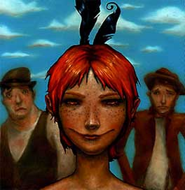
Tone and Mood O. Henry—”The Ransom of Red Chief”
“Gentlemen:
I received your letter today by post, in regard to the ransom you ask for the return of my son. I think you are a little high in your demands, and I hereby make you a counter-proposition, which I am inclined to believe you will accept. You bring Johnny home and pay me two hundred and fifty dollars in cash, and I agree to take him off your hands. You had better come at night, for the neighbors believe he is lost, and I couldn’t be responsible for what they would do to anybody they saw bringing him back.
Very respectfully,
Ebenezer Dorsett”
~O. Henry—“The Ransom of Red Chief”

Slide 3
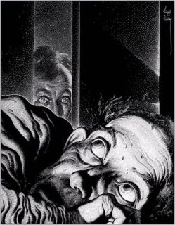
Tone and Mood Edgar Allan Poe—”The Tell-Tale Heart”
“True!—Nervous—very, very dreadfully nervous I had been and am; but why will you say that I am mad? The disease has sharpened my senses—not destroyed—not dulled them. Above all was the sense of hearing acute. I heard all things in the heaven and in the earth. I heard many things in hell. How, then, am I mad? Hearken and observe how healthily—how calmly I can tell you the whole story.
It is impossible to say how first the idea entered my brain; but once conceived, it haunted me day and night. Object there was none. Passion there was none. I loved the old man. He had never wronged me. He had never given me insult. For his gold I had no desire. I think it was his eye! Yes, it was this! One of his eyes resembled that of a vulture—a pale blue eye, with a film over it. whenever it fell upon me, my blood ran cold; and so by degrees—very gradually—I made up my mind to take the life of the old man, and thus rid myself of the eye forever.”
~Edgar Allan Poe—“The Tell-Tale Heart”

Slide 4
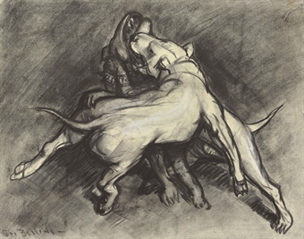
Tone and Mood Wilson Rawls—Where the Red Fern Grows
“I was walking along whistling when I heard the dogfight. At first paid no attention to it. after all it wasn’t anything to get excited about, just another dogfight in a residential section.
As the sound of the fight grew nearer, I could tell there were quite a few dogs mixed up in it. They boiled out of an alley, turned, and headed straight toward me. Not wanting to get bitten or run over, I moved over to the edge of the sidewalk.
I could see that all the dogs were fighting one. About twenty-five feet from me they caught him and down he went. I felt sorry for the unfortunate one. I knew if something wasn’t done quickly the sanitation department would have to pick up a dead dog.”
~Where the Red Ferns Grow—Wilson Rawls

Slide 5
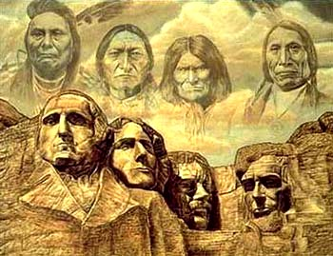
Tone and Mood Red Cloud—Indian Rights
“My brethren and my friends who are here before me this day, God Almighty has made us all, and He is here to bless what I have to say to you today. The Good Spirit made us both. He gave you lands and He gave us lands; He gave us these lands; you came in here, and we respected you as brother. God Almighty made you but made you all white and clothed you; when He made us He made us with red skins and poor; now you have come.
When you first cam we were very many, and you were few; now you are many, and we are getting very few, and we are poor. I am a representative of the original American race, the first people of this continent. We are good and not bad. The reports that you hear concerning us are all on one side. We are always well-disposed to them. You are here told that we are traders and thieves, and it is not so. We have given you nearly all our lands, and if we have anymore land to give we would be very glad to give it. We have nothing more. We are driven into a very little land, and we want you now, as our dear friends, to help us with the government of the United States”
~Indian Rights—Red Cloud

Slide 6
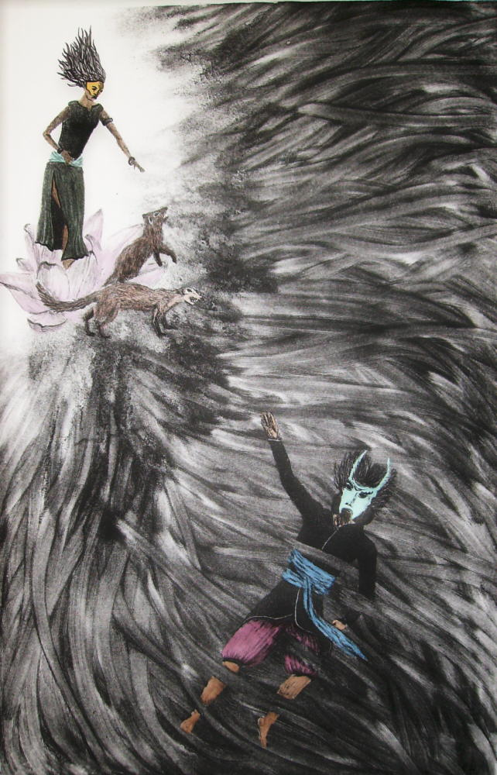
Tone and Mood Rudyard Kipling—”Rikki-tivvi-tavi”
“He spent all that day roaming over the house. He nearly drowned himself in the bathtubs, put his nose into the ink on a writing table, and burnt it on the end of the big man’s cigar, for he climbed up in the big man’s lap to see how the writing was done. At nightfall he ran into Teddy’s nursery to watch how kerosene lamps were lighted, and when Teddy went to bed, Rikki-tikki climbed up too; but he was a restless companion, because he had to get up and attend to every noise all through the night and find out what made it. Teddy’s mother and father came in, the last thing, to look at their boy, and Rikki-tikki was awake on the pillow.”
~”Rikki-tikki-tavi”—Rudyard Kippling

Slide 7
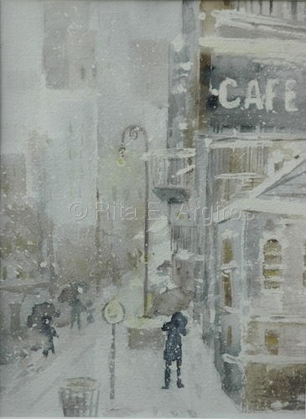
Tone and Mood Anton Chevhov—”Heartache”
“Evening twilight. Large wet flakes of snow circle lazily around the just lighted streetlamps and lie on roofs, horses’ backs, caps and shoulders in a thick, soft layer. Cabby Iona Potapov is all white as a ghost. As hunched over as a living body can be hunched, he sits on the box and does not stir. If a whole snowdrift were to fall on him, even then, it seems, he would not find it necessary to shake the snow off himself…He nag, too is white and motionless. In her motionlessness, angularity of shape, and stick-line straightness, even up close she looks like a penny gingerbread horse. In all probability she is sunk in thought. One who has been torn away from the plow, from the customary grey scenes, and been cast here, into this whirlpool of monstrous light, unceasing din, and rushing people, cannot help thinking…
It has been a long time since Iona and his horse have moved from their place. They left the stable before supper, and still there is no fare. But now evening darkness is descending on the city. The pale light of the streetlamps is surrendering its place to vivid color, and the bustle in the street is becoming noisier.”
~”Heartache”—Anton Chevhov

Slide 8
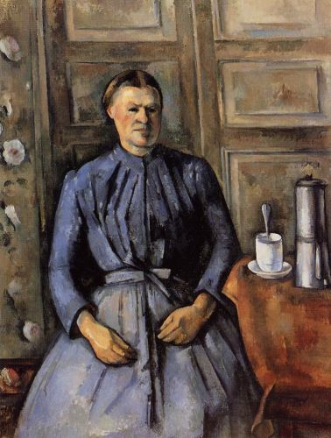
Tone and Mood Arthus Cavanaugh—”Miss Aweful”
“Miss Orville rapped her desk. ‘Attention, please, no muttering in the back.’ She cleared her voice and resumed. ‘Prior to my retirement I taught boys and girls for 46 years,’ she warned. ‘I am beyond trickery, so I advise you to try none. You are to be in my charge until the return of Miss Wilson, however long that may be.’ She clasped her hands in front of here and trained her full scrutiny on the rows. ‘Since I have no knowledge of your individual abilities, perhaps a look at the weekend homework will shed some light. Miss Wilson left me a copy of the assignment. You have all completed it, I trust? Take out your notebooks, please. At once, at once, I say.’
Roger’s head spun dizzily around. He gaped at the monstrous tweed figure in dismay. Book bags were being clicked open, notebooks drawn out—what was he to do? He had gone to his room after the outing in the park yesterday, but, alas, it had not been to complete his assignment. He watched, horrified, as the tweed figure proceeded among the aisles and inspected notebooks. What had she said her name was? Awful—was that it? Miss Awful! Biting his lip, he listened to her scathing comments.
~”Miss Awful”—Arthus Cavanaugh

Slide 9
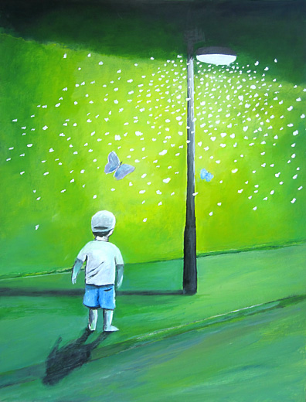
Tone and Mood Jean Fritz—”Homesick”
“’Is there something wrong with your voice today, Jean?’ she asked.
‘No, Miss Williams. It is not my national anthem.’
‘I is the national anthem we sing here,’ she snapped. ‘You have always sung. Even Vera sings it.’
I looked at Vera with the big blue bow tied on the top of her head. Usually I felt sorry for her but not today. At recess I might even untie that bow, I thought. Just give it a yank. But if I’d been smart, I wouldn’t have been looking at Ian Forbes and I would have known that no matter what Miss Williams said, I wasn’t through with the king of England.
Recess at the British school was nothing I looked forward to. Every day we played a game called prisoner’s base, which was all running and shouting and shoving and catching. I hated the game, yet everyone played except Vera Sebastian. She sat on the sidelines under her blue bow like someone who had been dropped out of a history book…I was looking up at a little white cloud skittering against the sky when all at once someone tramped down hard on my right foot. Ian Forbes. Snarling bulldog face. Heel grinding down on my toes. Head thrust forward like an animal might before it strikes.
‘You wouldn’t sing it. So say it,’ he ordered.
‘God save the king. Say it. Those four words. I want to hear you say it.’
‘Why should i? Americans haven’t said that since George the Third.’
He grabbed my right arm and twisted it behind my back.
‘Say it,’ he hissed.
‘I’ll never say it,’ I whispered.
~”Homesick”—Jean Fritz

Slide 10
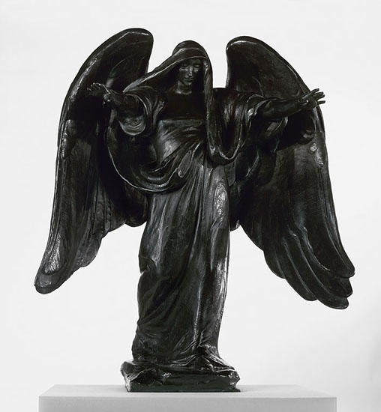
Tone and Mood Edgar Allan Poe—”The Raven”
“Ah, distinctly I remember it was in the bleak December;
And each separate dying ember wrought its ghost upon the floor.
Eagerly I wished the morrow—vainly I had sought to borrow
From the books surcease of sorrow—sorrow for the lost Lenore—
For the rare and radiant maiden whom the angels name Lenore—
Nameless here for evermore.”
~”The Raven”—Edgar Allan Poe

Slide 11
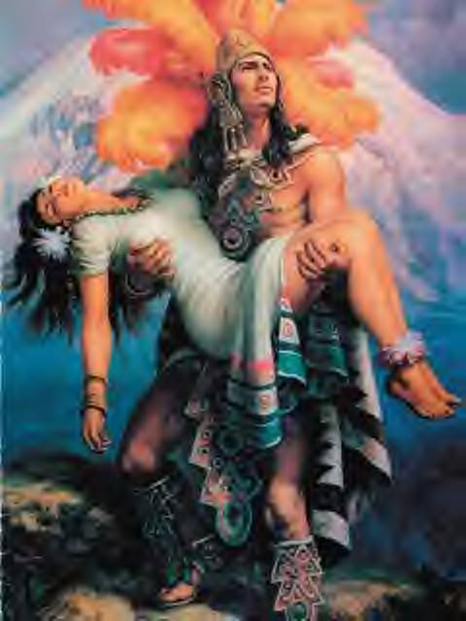
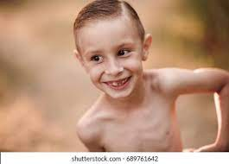
Tone and Mood Gary Soto—”broken Chain”
“Alfonso sat on the porch trying to push his crooked teeth to where he thought they belonged. He hated the way he looked. Last week he did fifty sit-ups a day, thinking that he would burn those already apparent ripples on his stomach to ever deeper ripples, dark ones, so when he went swimming at the canal next summer, girls in cut-offs would notice. And the guys would think he was tough, someone who could take a punch and give it back. He wanted “cuts” like those he had seen on a calendar of an Aztec warrior standing on a pyramid with a woman in his arms. (Even she had cuts he could see beneath her thin dress.) The calendar hung above the cash register at La Plaza. Orsua, the owner, said Alfonso could have the calendar at the end of the year if the waitress, Yolanda, didn’t take it first.”
~”Broken Chain”—Gary Soto

Slide 12
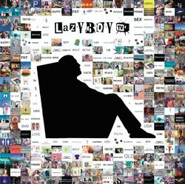
Tone and Mood Russel Baker—”No Gumtion”
“I began working in journalism when I was eight years old. It was my mother’s idea. She wanted me to ‘make something’ of myself and, after a level-headed appraisal of my strengths, decided I had better start young if I was to have any chance of keeping up with the competition.
The flaw in my character which she had already spotted was lack of ‘gumption.’ My idea of a perfect afternoon was lying in front of the radio rereading my favorite Big Little Book, Dick Tracy Meets Stooge Viller. My mother despised inactivity. Seeing me having a good time in repose, she was powerless to hide her disgust. ‘You’ve got no more gumption than a bump on a log,’ she said. ‘Get out in the kitchen and help Doris do those dirty dishes.’”
~”No Gumption”—Russell Baker

Slide 13
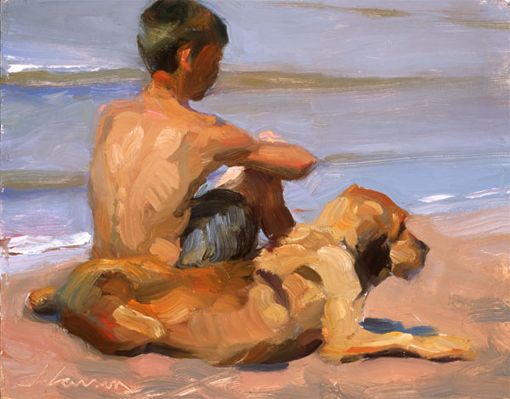
Tone and Mood Martha Brooks—”A Boy and His Dog”
“My dog is old. His eyes are constantly running on account of he’s going blind. Sometimes when we go for his walk he falls down. We’ll just be moving right along, I’ll feel an unexpected tug at his leash and bingo! He’s over. The first time it happened he cried, sort of whimpered, and looked at this leg, the back one, the one that had betrayed him. I crouched in the tall grass (we take our walks in a sky-filled prairie field near the townhouses where we live) and felt the leg, which was in a spasm. I told him if it didn’t work too well to just give up for a while. He seemed to know what I was telling him because he looked at me, whimpered some more, and finally flopped his head back on my leg. That’s what kills me about dogs. They figure out you’re in charge of everything. Like if you pointed your finger, you could make a house fall down. Or if you told them everything’s going to be okay, it would be.’’
~”A Boy and His Dog”—Martha Brooks

Slide 14
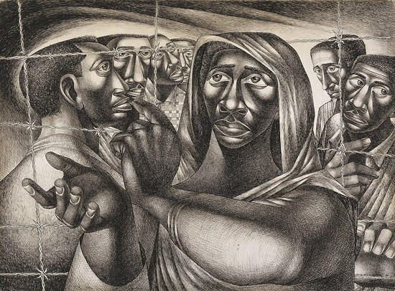
Tone and Mood Ann Petry—”Harriet Tubman: Guide to Freedom”
“She had to take them all the way to Canada. The Fugitive Slave Law was no longer a great many incomprehensible words written down on the country’s law books. The new law had become a reality. It was Thomas Sims, a boy picked up on the streets of Boston at night and shipped back to Georgia. It was Jerry and Shadrach, arrested and jailed. With no warning.
She had never been in Canada. The route beyond Philadelphia was strange to her. But she could not let the runaways who accompanied her know this. As they walked along she told them stories of her own first flight, she kept painting vivid word pictures of what it would be like to be free.
But there were so many of them this time. She knew moments of doubt when she was half-afraid, and kept looking back over her shoulder, imagining that she heard the sound of pursuit. They would certainly be pursued. Eleven of them. Eleven thousand dollars’ worth of flesh and bone and muscle that belonged to Maryland planters. If they were caught, the eleven runaways would be whipped and sold South, but she—she would probably be hanged.”
~”Harriet Tubman: Guide to Freedom”—Ann Petry

Slide 15
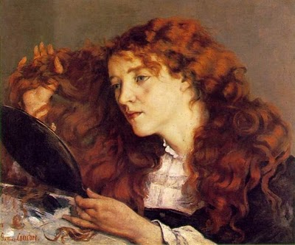
Tone and Mood Jean Kerr—”My Wild Irish Mother”
“The youngest daughter of wealthy and indulgent parents, Mother went to finishing schools in France and to the Royal Conservatory of Music in London. Thus, when she came to America to marry my father, her only qualifications for the role of housewife and mother were the ability to speak four languages, play three musical instruments, and make blancmange…By the time I was old enough to notice things, Mother was an excellent cook.
…She was always willing to prepare all manner of exotic dishes for Dad and the rest of us. In the old days the men who worked for my father frequently gave him gifts of game—venison, rabbit, and the like. Occasionally we children would protest. I recall becoming quite tearful over the prospect of eating deer. On the theory that it might be Bambi. But Mother was always firm. ‘Nonsense,’ she would say, ‘eat up. It’s just like chicken.’
But one night she went too far. I don’t know where she got this enormous slab of meat…It stood overnight in the icebox in some complicated solution…The next day the four of us were told that we could each invite a friend to dinner. Mother spent most of the day lovingly preparing her roast. That night there were ten of us around the dining-room table, and if Mother seemed too busy serving all the rest of us to eat anything herself, that was not at all unusual. At this late date I have no impression of what the meat tasted like. But I know that we were all munching away when Mother beamed happily at us and asked, ‘Well, children, how are you enjoying the bear?’
Forks dropped and certain of the invited guests made emergency trips to the bathroom. For one, all of Mother’s protestations that it was just like chicken were unavailing. Nobody would touch another bite. She was really dismayed. I heard her tell Dad, ‘It’s really strange, Tom—I thought all Americans liked bear.’”
~”My Wild Irish Mother”—Jean Kerr

Slide 16
Tone and Mood
Website Resources:
www.googleartproject.com
www.cartermuseum.org

